Slide 1
Interface µModule Isolators

Slide 2

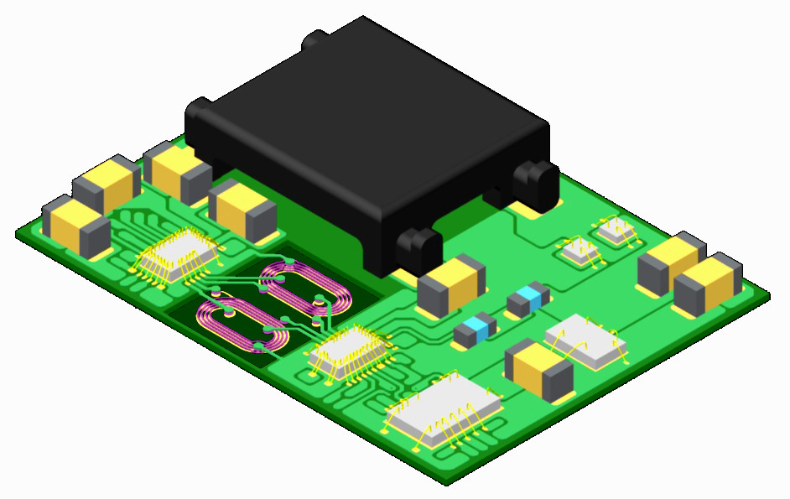
Isolator µModule® Technology
(11.25mm x 15mm x 3.4mm)
Transformer
Decoupling Caps
Diodes
Isolators
Coupled Signal Inductors
LDO
LTC Application Die (if applicable)
Notes:
This is Linear’s Isolator µModule® Technology, a new development platform that allows Linear to reliably integrate inductive/magnetic isolation, discrete components, ICs and power onto a single substrate PCB. The platform allows Linear to quickly develop a wide variety of isolated products, since the major building blocks can be easily interchanged per the application; digital interfaces can be swapped out - parallel data, SPI, I²C, etc. can all be supported, transformers can be sized accordingly, and discrete components can be changed. As a result, Linear can quickly respond to the Market’s integrated isolation needs.

Slide 3
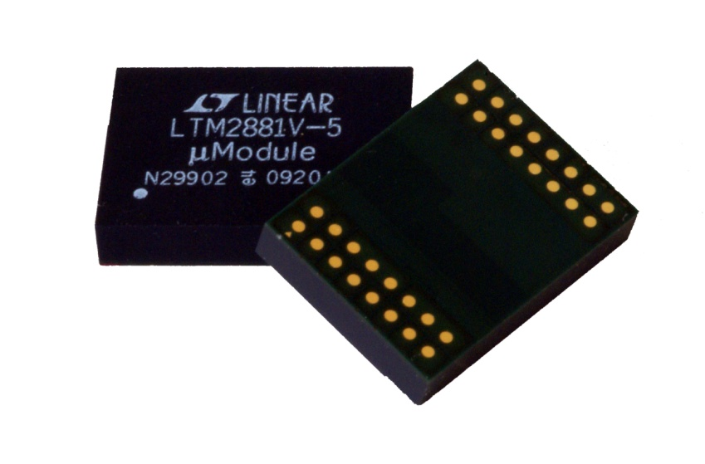
Isolator µModule® Technology: Features & Benefits
APPLICATION:
  High level of functional integration – No external components!
  Integrate any application with this isolation technique
POWER:
  High power levels (up to 1W)
  Surplus Power for the application
ISOLATION:
  Substrate PCB supports high Isolation (>2500V_{RMS})
  Certifications Pending: UL, CSA, IEC
  EMC Ratings Pending: Emissions & Immunity
COMMUNICATION:
  Differential signaling and encoding yield superior signal integrity
  Prioritized, event driven, data encoding produces jitter free signals
  High data rates (20Mbps)
  Superior common mode transient immunity (>30kV/µs)
Notes:
The features and benefits of the Isolator µModule Technology platform are numerous. First of all, there is a very high level of integration, resulting in products that require no external components. All resistors, capacitors, inductors and ICs are onboard. Any application from signaling to sampling or digital to analog is supported by the platform, easily bringing isolation to even non-traditional applications.
High power levels (up to 1W), supported by low ripple regulation, a cored power transformer that reduces radiated emissions, and better-than-average efficiency up to 62%, is available to the application. Not only is the device self-powered, but it also provides external isolated power for other neighboring functions.
To achieve greater than 2500V_{RMS} isolation, the technology uses coupled signal inductors embedded in our μModule substrate. This technique ensures consistent ruggedness and reliability. This platform will be certified by safety houses, including UL, CSA and IEC to guarantee the isolation barrier’s effectiveness. In addition, we will publish EMC results for both emissions and immunity (both electrical and magnetic) to assure customers that interference will not be an issue.
Communication via the Isolator µModule Technology platform is second to none. Differential signals are supported by a high signal to noise ratio, error checking, and data retention refresh to ensure superior signal integrity. If in the rare case that there is any loss in communication, the device will trigger a safe shutdown mode, where the outputs default to high impedance. This is important, so that a faulted device does not lock up a shared communication bus. Prioritized, event driven, data encoding and decoding across the isolation barrier produces jitter free signals and high data rates, 20Mbps now but up to 100Mbps in the near future, can be supported. Lastly, but certainly not any less impressive, the platform boasts superior common mode transient immunity (>30kV/µs minimum) that allows the user to continue communication through common mode transient events. Competing products only hold the previous output state. The Isolator µModule Technology is unaffected by the transient and does not even introduce any priority data jitter.

Slide 4
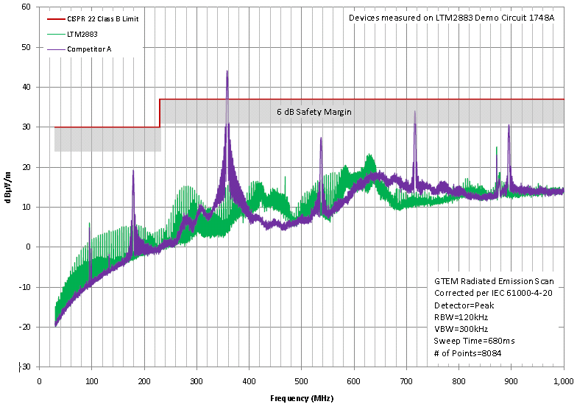
Low EMI – Example: LTM2883 vs. Competition
Notes:
When laid down on a board, the Interface uModule Isolators meet the requirements of EN 55022 Class B radiated emissions provided a few simple practices are followed. Shown here is the LTM2883 in green, staying well below the red line representing the Class B limit and gray shaded area representing 6dB’s worth of safety margin, while Competitor A in purple clearly violates these thresholds. In some cases, such as with the LTM2881 and LTM2882, standard demonstration boards do not implement EMI mitigation techniques. However, low EMI versions of the demo boards implement techniques to improve demo board performance, and offer suggestions on part application for new designs.

Slide 5
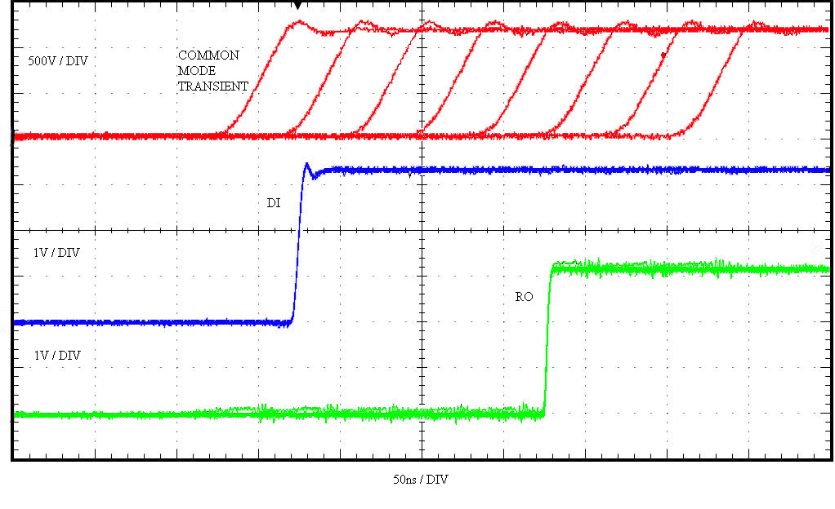
35kV/μs Common Mode Transient Immunity
DI-> (Y=A, Z=B) ->RO, no jitter or corruption during CM transients
Notes:
Here’s a closer look at the common mode transient immunity, provided by the Isolator µModule Technology, demonstrating the impressive isolation performance. The plot in red, shows several common mode transients introduced to the system before, during and after communication . The slew rate of the transients are roughly 1kV per 28ns or 35kV/µs. The driver, in blue, continues to drive data and the receiver, in green, in a loop back configuration and consistently outputs the data on RO with no jitter or corruption of data. The propagation delay is from two transmissions across the barrier with the loopback through the RS485 driver and receiver back to the logic side RO output. While other isolation solutions may only hold state during a transient event, the Isolated µModule Technology provides continuous communication during these harsh system events, with guaranteed high common mode transient immunity of 30kV/µs.

Slide 6
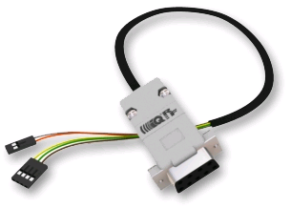
Isolated Interface Product Markets:
Industrial Equipment
  Process Controllers
  Data Acquisition
  Motor Controllers
  Programmable Logic Controls
  ( PLC)
  Factory Automation
Medical
  Patient Monitoring
  Medication Dispensing
Road Signs, Traffic Lights,
Aircraft, Airport Lighting
Trains and Railroad Signage
Home: Security Systems
Building Controls
  Heating Ventilating and
  Air Conditioning (HVAC)
  Security Systems
Heavy Equipment
  Cranes, Forklifts
  Oil Drilling
  Conveyor Systems
Metering
  Toll Collection
  Supermarket Scales
  Water/Liquid Flow Metering

Slide 7
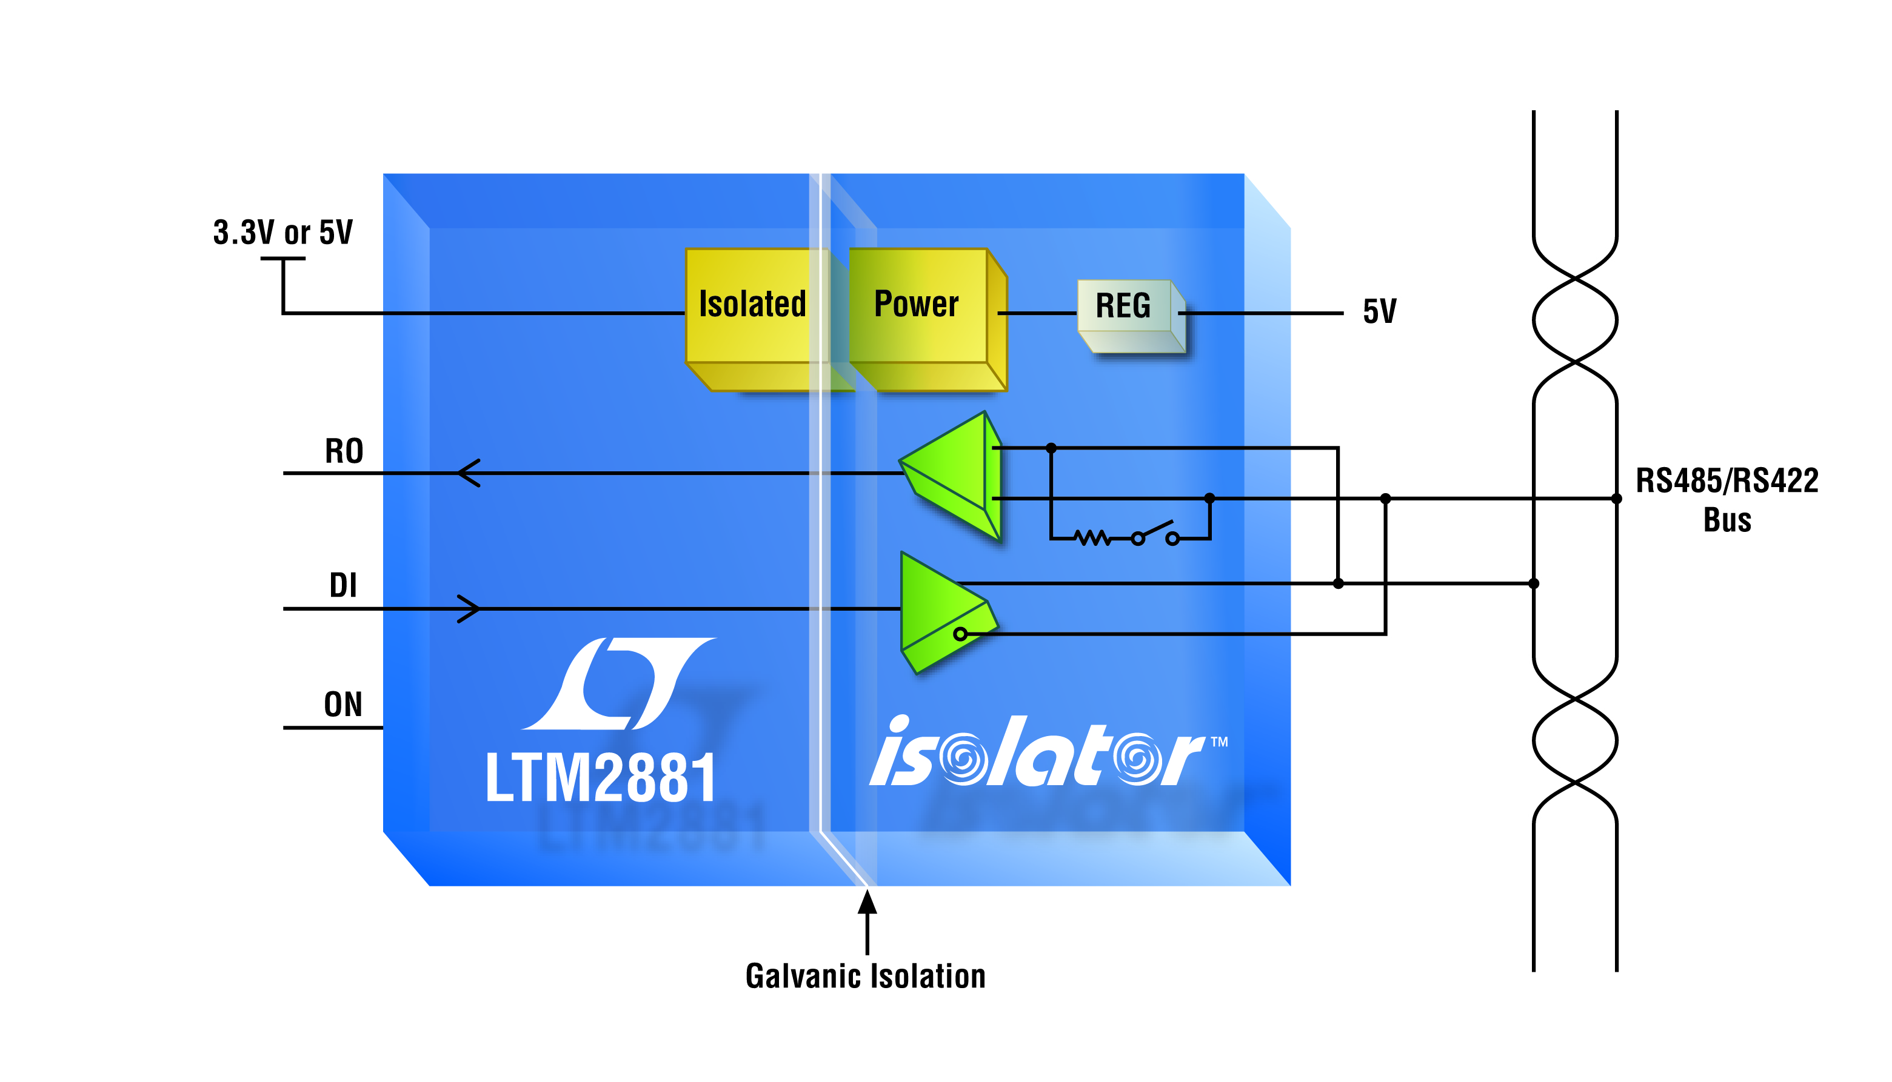
LTM2881: Complete Isolated RS485/RS422 µModule Transceiver + 1W Power
Features:
Isolator µModule Technology
Isolation: 2500V_{RMS}@1MIN, 560V_{PEAK}@LIFE
Integrated, Isolated 1W DC/DC Converter
Data Rate: 20Mbps or Low-EMI 250kbps
Selectable 120Ω Termination
CM Transient Immunity: >30kV/μs
High ESD: ±15kV HBM
Logic Interface: V_{L} = 1.62V to 5.5V
Spare isolated logic output (fault detect)
Supports PROFIBUS
3.3V (LTM2881-3) or 5V (LTM2881-5) Operation
Low Profile Surface Mount LGA and BGA Packages
Notes:
The LTM2881 is an isolated RS485/RS422 transceiver that guards against large ground-to-ground differentials. This isolated RS485/RS422 solution integrates a 2500V_{RMS} galvanic isolation barrier, a high performance transceiver and all necessary power components into low profile LGA and BGA packages. Absolutely no external components are required. In addition, the LTM2881 provides surplus current for powering external circuits via a 5V well-regulated output
The LTM2881 communicates by default at 20Mbps, but has a pin-selectable reduced slew rate mode that limits the data rate to 250kbps and softens the driver output edges to reduce EMI emission from equipment and data cables.
Integrated selectable 120Ω termination is available to minimize reflections that can occur on improperly terminated transmission lines. RS485 networks require 120-Ohm termination resistors to be installed by the end user based on the physical layout of the twisted-pair wires and the placement of the nodes. As the bus is extended, or nodes moved or removed, the termination location must be changed again by the user. The pin-selectable termination allows the proper nodes to be terminated by switching the integrated termination on or off, under software control, without the need for physical intervention by the user. Additionally, the integrated termination provides an overall smaller solution size. The high input/output impedance of the device allows users to connect up to 256 LTM2881’s on a single RS485 bus.
The LTM2881 offers a 1.62V to 5.5V logic supply pin to provide a convenient to interface to digital components, while still maintaining TIA/EIA compliant RS485 signals with either a 3.3V or 5V supply. In addition, LTM2881 offers a low current shutdown mode of less than 10µA via a dedicated ON pin.
The LTM2881 offers a lot of valuable protection that will be appreciated in real world applications. Enhanced ESD protection allows this part to withstand up to ±15kV (human body model) on the transceiver interface pins to isolated supplies and ±10kV through the isolation barrier to logic supplies without latch-up or damage. The LTM2881 goes beyond the traditional open-input failsafe that only works if the receiver inputs are completely floating and adds failsafe under shorted or terminated, but not driven, conditions. This failsafe feature eliminates the need to pre-bias the RS485 network and balances receiver thresholds to maintain data duty cycle with long network connections. While the driver offers overcurrent protection, the LTM2881 also protects itself by disabling the driver and receiver outputs in the case of excessive power dissipation.

Slide 8
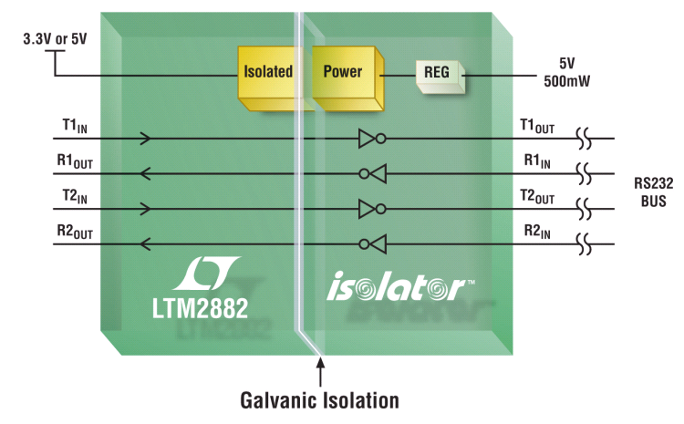
LTM2882: Dual Isolated RS232 µModule®
Transceiver + 1W Power
Features:
Isolator µModule Technology
Isolation: 2500V_{RMS}@1MIN, 560V_{PEAK}@LIFE
Integrated Isolated DC/DC Converter
Logic Interface: V_{L} = 1.62V to 5.5V
High Speed Operation (Up to 1Mbps)
No Damage or Latchup to ±10kV ESD (HBM) on Isolated RS232 Interface and across Isolation Barrier
CM Transient Immunity: >30kV/μs
3.3V (LTM2882-3) or 5V (LTM2882-5) Operation
Low Profile Surface Mount LGA and BGA Packages
Notes:
The LTM2882 is a dual isolated RS232 transceiver that guards against large ground-to-ground differentials. This isolated RS232 solution integrates a 2500V_{RMS} galvanic isolation barrier, a high performance transceiver and all necessary power components into low profile LGA and BGA packages. Absolutely no external components are required. In addition, the LTM2882 provides surplus current for powering external circuits via a 5V well-regulated output.
The LTM2882 communicates at up to 1Mbps with slew rate limited outputs that soften the driver output edges to reduce EMI emission from equipment and data cables.
The LTM2882 offers a 1.62V to 5.5V logic supply pin to provide a convenient interface to digital components, while still maintaining RS232 compliant output signals with either a 3.3V or 5V supply. In addition, LTM2882 offers a low current shutdown mode of less than 10µA via a dedicated ON pin.
The LTM2882 offers a lot of valuable protection that will be appreciated in real world applications. Enhanced ESD protection allows this part to withstand up to ±10kV (human body model) on the transceiver interface pins to isolated supplies and ±10kV through the isolation barrier to logic supplies without latch-up or damage. The driver outputs are protected from short-circuits to any voltage within the absolute maximum range of ±15V relative to GND2. The maximum current is limited to no more than 70mA to maintain a safe power dissipation and prevent damaging the LTM2882. The receiver inputs are protected from common mode voltages of ±25V relative to GND2, while an open circuit condition will generate a logic high on each receiver’s respective output pin.

Slide 9
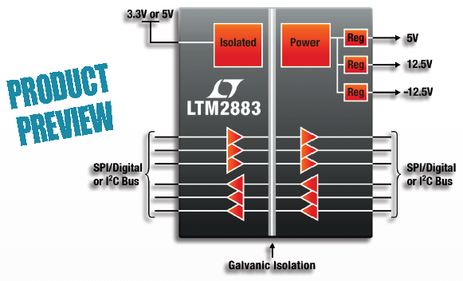
LTM2883: SPI/Digital or I²C µModule® Isolator with
Adjustable ±12V and 5V Power
Features:
Isolator µModule Technology
Six Channel Logic Isolator: 2500V_{RMS}
Isolated Adjustable DC Power
  3V to 5V at Up to 30mA
  ±12.5V at Up to 25mA
High Speed Operation
  10MHz Digital Isolation
  4Mhz/8MHz SPI Isolation
  400kHz I²C Isolation
CM Transient Immunity: >30kV/μs
3.3V (LTM2883-3) or 5V (LTM2883-5) Operation
Low Profile Surface Mount BGA Package

Slide 10
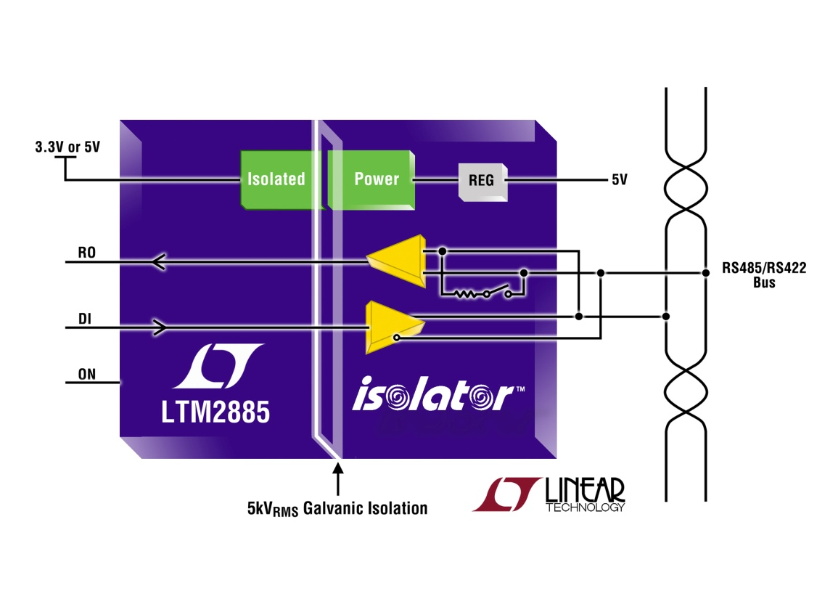

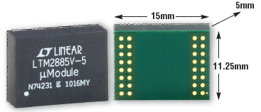
LTM2885: 4kV Isolated RS485/RS422 µModule Transceiver + 1W Power
Features:
Isolator µModule Technology
Isolation: 4kV_{RMS}@1MIN, 890V_{PEAK}@LIFE
Integrated, Isolated 1W DC/DC Converter
CM Transient Immunity: >30kV/μs
Data Rate: 20Mbps or Low-EMI 250kbps
High ESD: ±15kV HBM
Selectable 120Ω Termination
Logic Interface: V_{L} = 1.62V to 5.5V
Spare isolated logic output (fault detect)
Supports PROFIBUS
3.3V (LTM2885-3) or 5V (LTM2885-5) Operation
15mm x 11.25mm BGA Package

Slide 11
Interface µModule Family
Device Selection
P/N | Interface | Isolation Rating | Safety Certifications | Adjustable Power Rails | Supply Options | Temperature Grade | Package
LTM2881 | RS485 | 2.5kV_{RMS} | UL, CSA, VDE | 5V | 3V, 5V | C, I, H, MP | 32-pin LGA or BGA
LTM2882 | RS232 | 2.5kV_{RMS} | UL, CSA, VDE | 5V | 3V, 5V | C, I, H, MP | 32-pin LGA or BGA
LTM2883 | SPI/I²C | 2.5kV_{RMS} | UL, CSA, VDE | 5V, 12V, -12V | 3V, 5V | C, I, H | 32-pin BGA
LTM2885 | RS485 | 4kV_{RMS} | UL, CSA, VDE | 5V | 3V, 5V | C, I, H | 32-pin BGA

